Slide 1
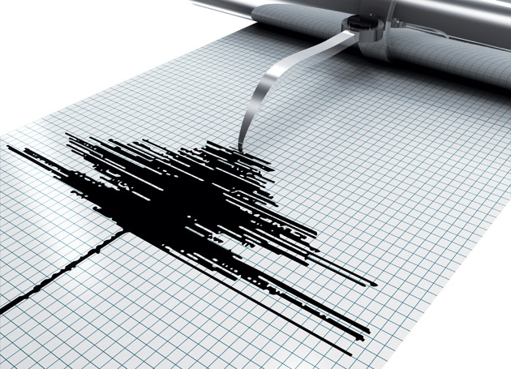
Welcome to Earthquake Engineering
Welcome to Earthquake
(and Structural)
Engineering
October 11, 2014
Notes:
What is civil engineering? What is structural engineering?

Slide 2
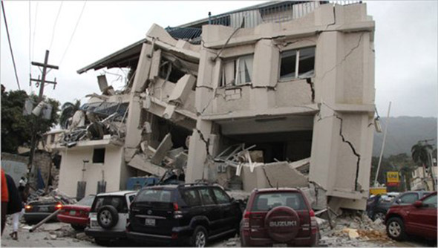
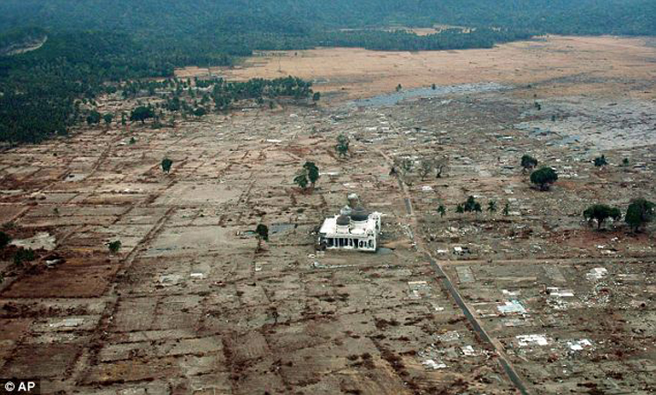
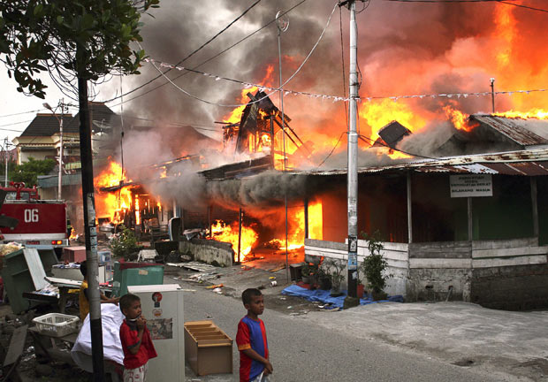
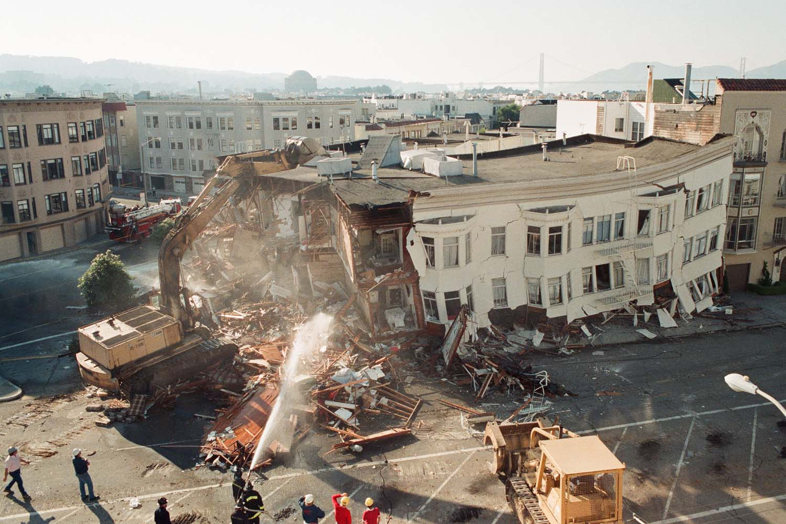
Why care about EQ Engineering?

Slide 3
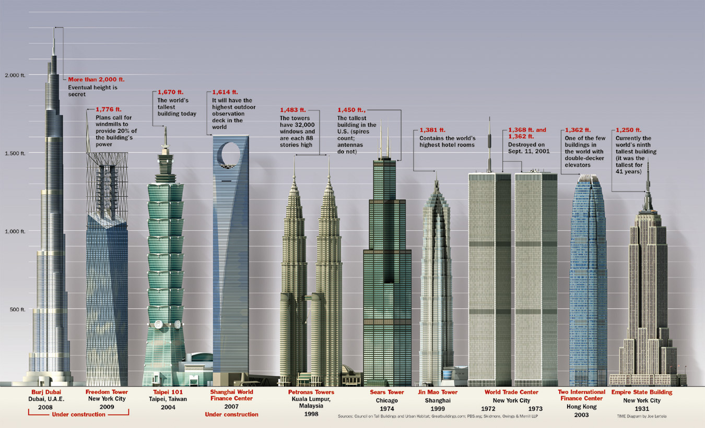
Structural Engineering Examples
Notes:
What are these buildings?

Slide 4
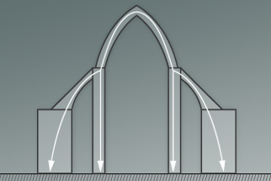
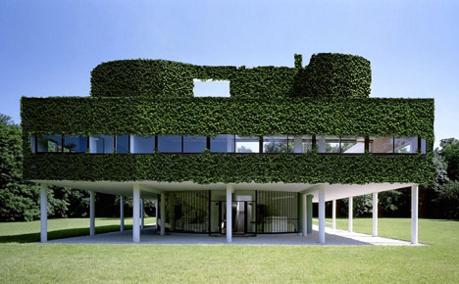
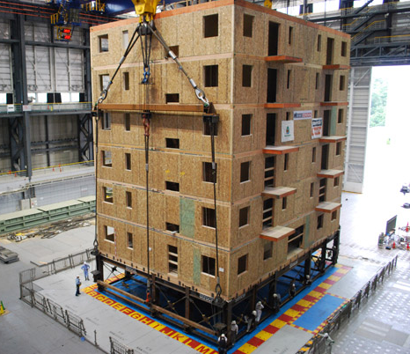
Architecture vs. Engineering
Notes:
Architects think first about style… Engineers think first about safety. Architect think about how the building looks… Engineers think about how will the building stand up.

Slide 5
What is Structural Engineering?
Building structures…
with respect for forces of nature
What are these forces?

Slide 6
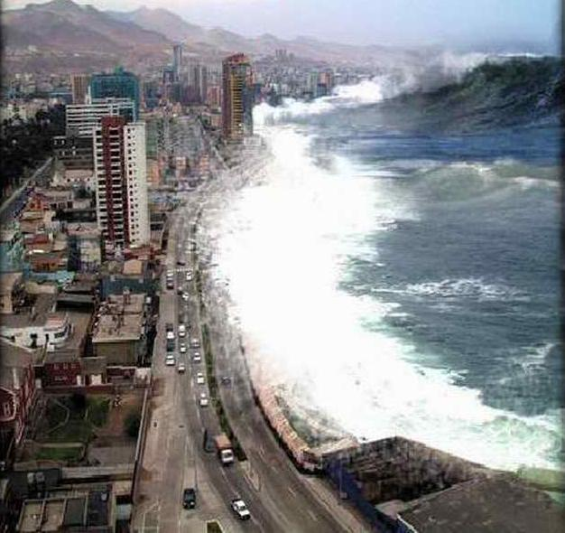
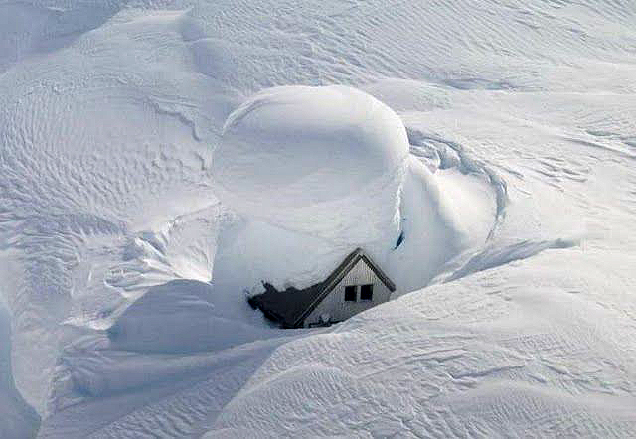
What is Structural Engineering?
Building structures…
with respect for forces of nature
Water
Soil
Wind
Seismic

Slide 7
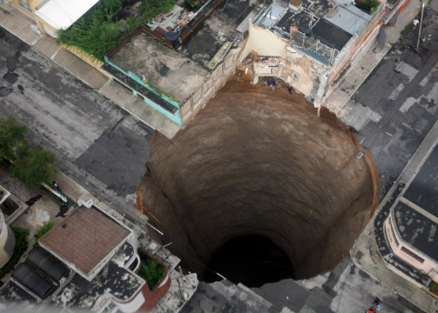
What is Structural Engineering?
Building structures…
with respect for forces of nature
Water
Soil
Wind
Seismic

Slide 8
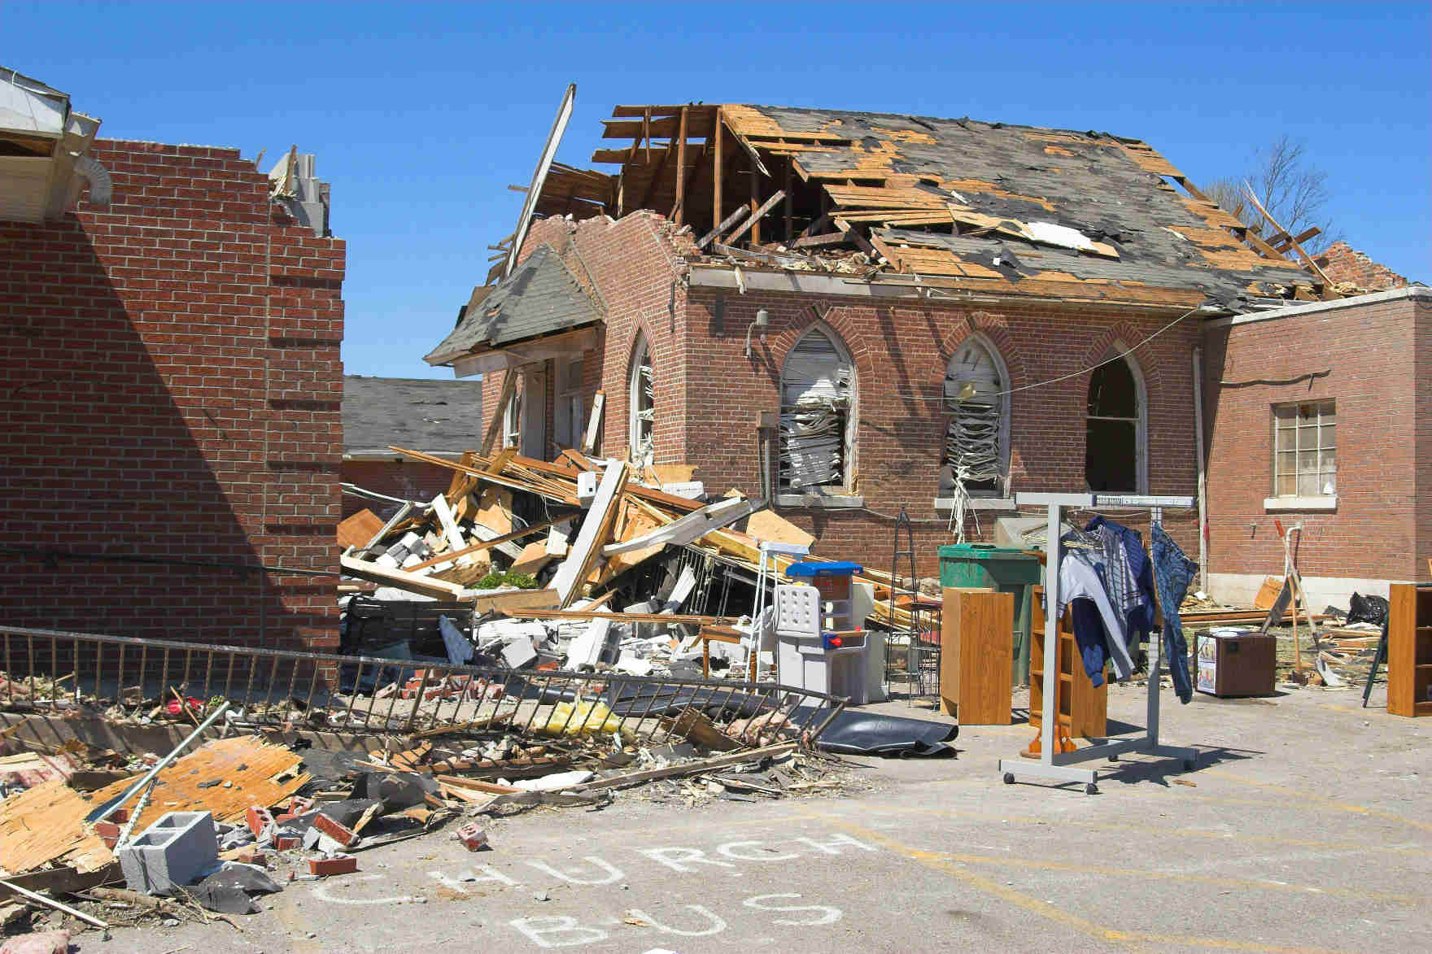
What is Structural Engineering?
Building structures…
with respect for forces of nature
Water
Soil
Wind
Seismic

Slide 9
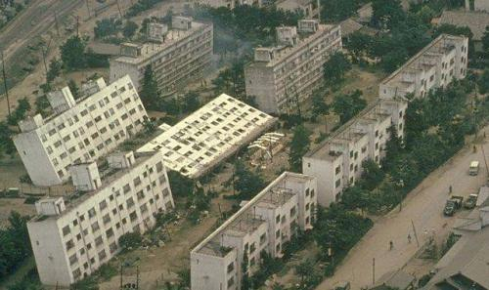
What is Structural Engineering?
Building structures…
with respect for forces of nature
Water
Soil
Wind
Seismic

Slide 10
What is Structural Engineering?
Building structures…
with respect for forces of nature
Water
Soil
Wind
Seismic
Special Case
Blasts

Slide 11
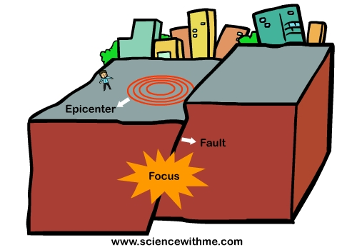
What is an Earthquake?
Notes:
Earthquakes are one of the dynamic loads that structural engineers worry about. If a building is not designed or constructed to perform well during an earthquake, people’s lives and property are in danger

Slide 12
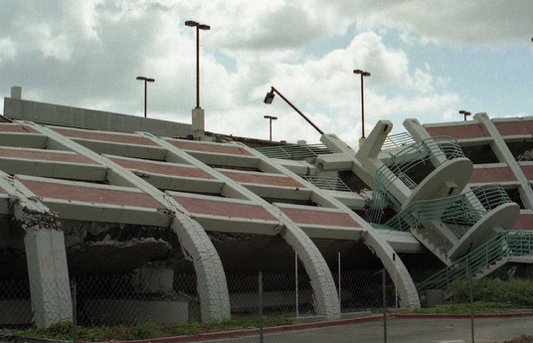
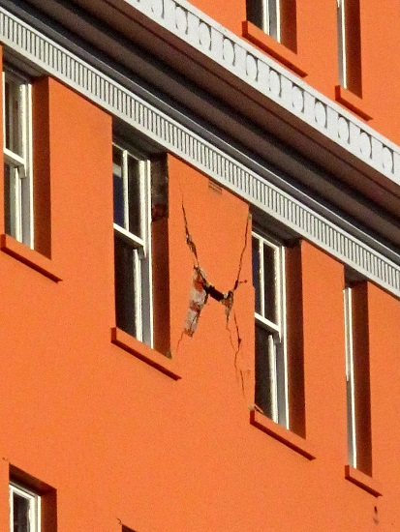
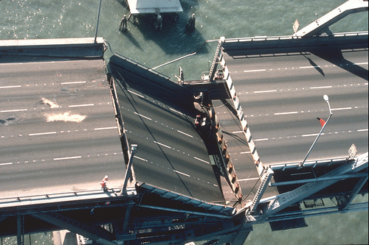
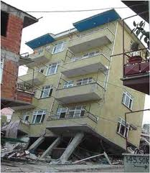
What is an Earthquake?

Slide 13
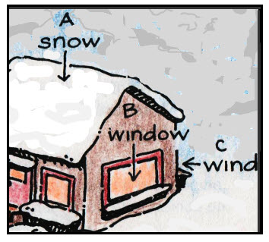
What Do We Need to Know?
STATICS
DYNAMICS
COST
SAFETY
Notes:
Statics = weight of the building and its contents
Dynamics = outside forces that push on or down on the building (snow, wind, earthquakes)
Cost = Materials
Safety = Who uses the building, what risks will it face

Slide 14
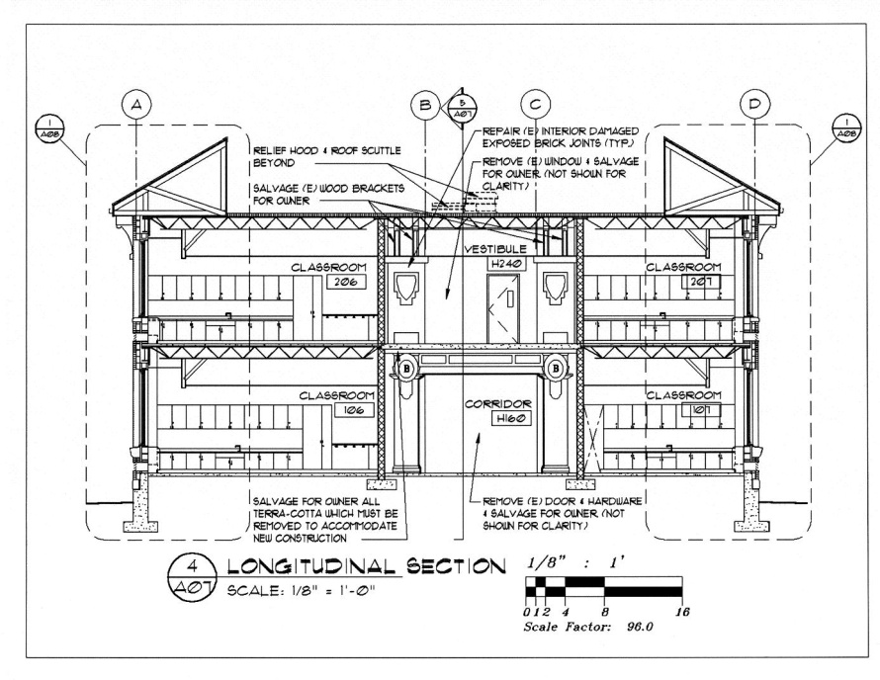
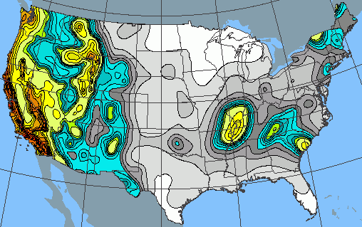
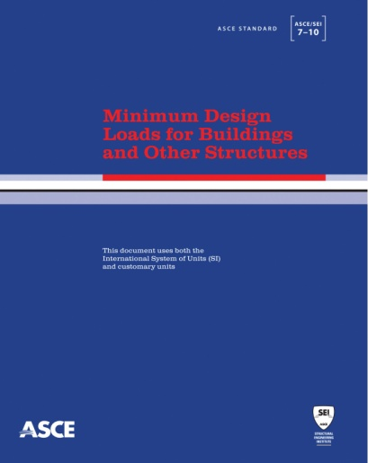
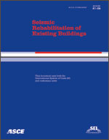
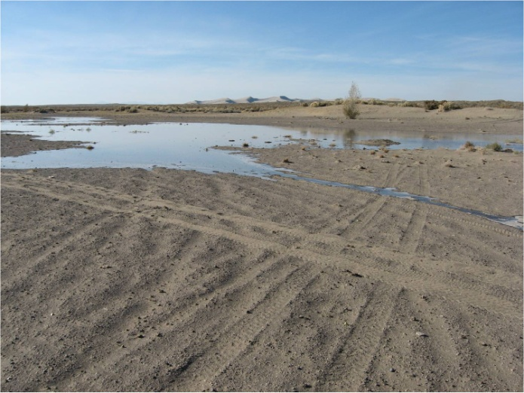
Components of Building Design
Notes:
Hazard maps (what dynamic loads will it encounter)
Building plan (what do the clients want, and how will those elements be supported)
Building codes and standards that say how a building should be designed
Site conditions (what is ground like underneath the structure)

Slide 15
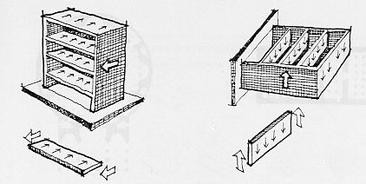
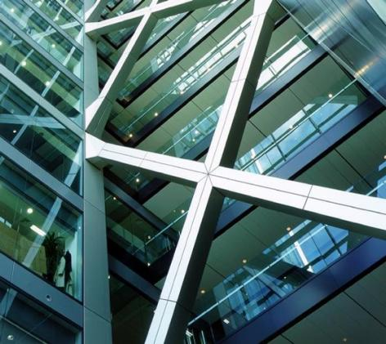
Load Path & Lateral Resistance
Notes:
Load path = how will the loads travel through your structure
Lateral force resistance = what resists the forces coming sideways

Slide 16
Stiffness & Stability
Notes:
Stiffness—don’t want to be too flexible (swaying like a palm tree)… or too rigid
Mass—where is most of your weight located (all on top like a water tower… all in one place like a boulder…)

Slide 17
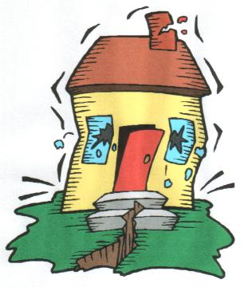
Today’s Activity
Goal:
Design a gumdrop building to perform well during a jello earthquake

Slide 18
Today’s Activity
Break into small groups
Develop a group name
Discuss building ideas together (consider the client needs!)
Build towers (30-45 min)
Evaluate buildings
Lessons learned

Slide 19
Project Criteria
Client Needs
Minimum height = 12 inches
Maximum floor area = 6 in²
Maximum gum drops used
Aesthetic Appeal
Visually interesting
Static Performance
Resists gravity load
Dynamic Response
Resists earthquake load

